Slide 1

Hospital Management System

Slide 2
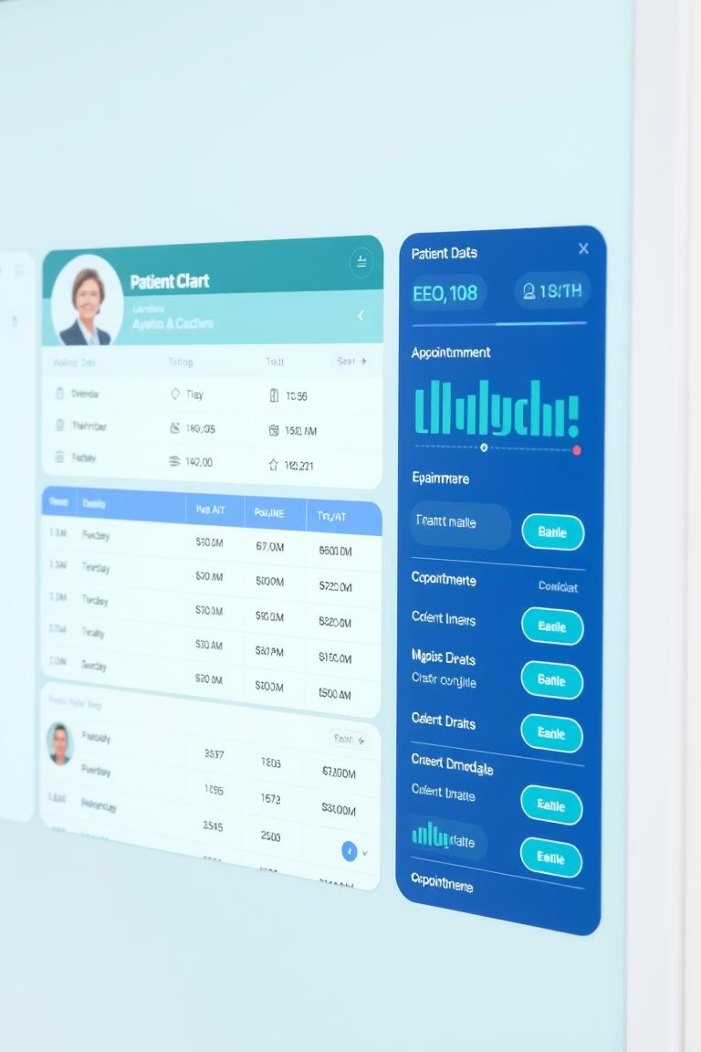
Abstract
The Hospital Management System is a web-based tool that helps manage patient records, doctor assignments, and appointments easily.It replaces manual work with automation, saving time and reducing errors.Built with HTML, CSS, PHP, and MySQL using XAMPP, it ensures secure and accurate data handling.This system is ideal for hospitals and clinics to improve efficiency and organize daily operations better.

Slide 3
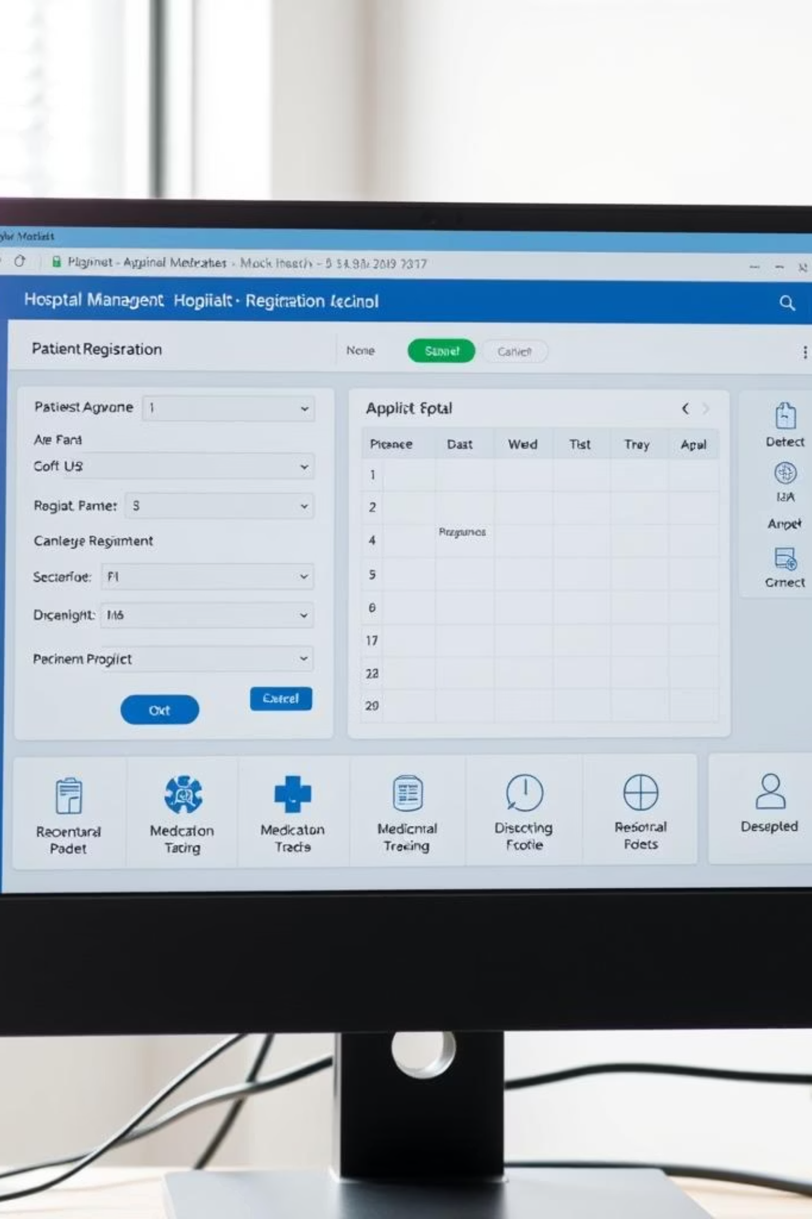
Objective
Automate hospital tasks like patient registration, doctor assignment, and appointments.
Store all data securely in one place for easy access and management.
Provide real-time access to records and appointment details through a web interface.
Ensure the system is easy to use and ready for future upgrades.
Reduce human errors and save time by replacing manual processes with digital solutions.

Slide 4





Technology Stack
Frontend
Developed using HTML and CSS for a user-friendly interface.
Backend
PHP handles server-side logic and data processing.
Database
MySQL ensures secure and accurate data handling.
Environment
XAMPP provides a local server for easy deployment.

Slide 5




Core System Features
Patient Registration
Efficiently manage new and existing patient records.
Doctor Management
Assign doctors to departments and track specializations.
Appointment Scheduling
Streamline booking and real-time access to timings.

Slide 6
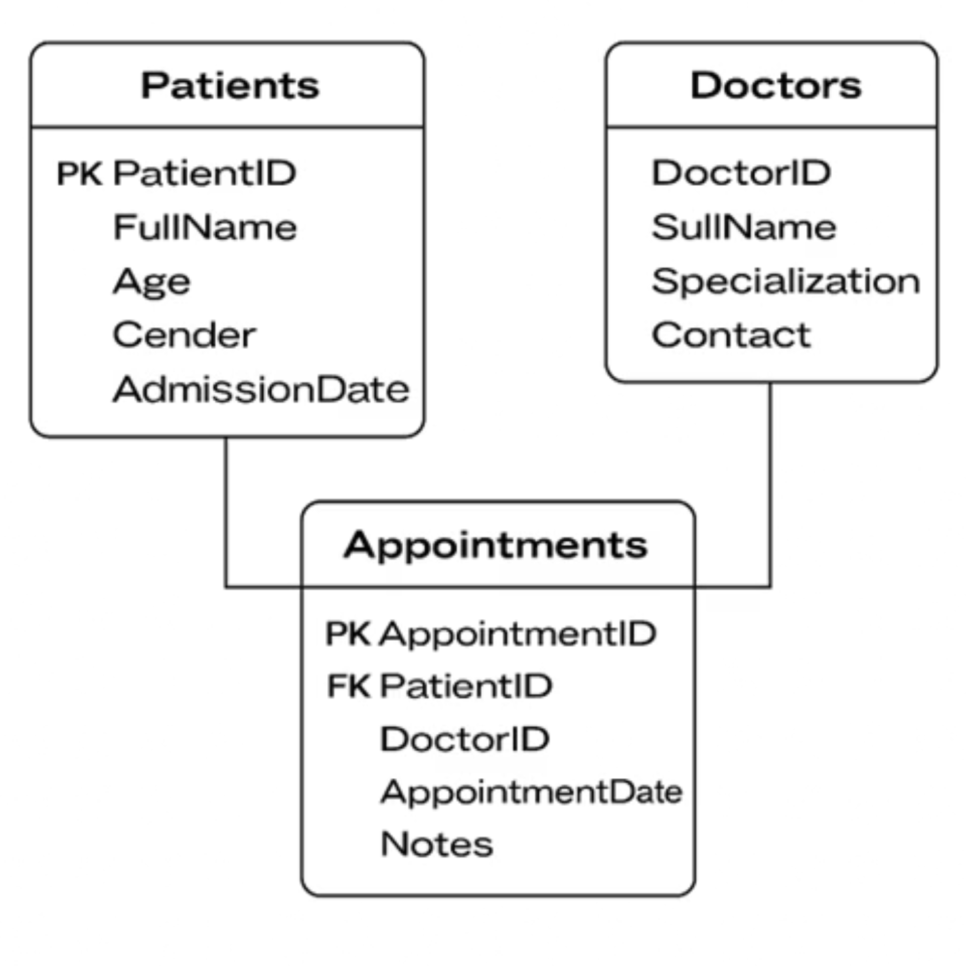
ER Diagram

Slide 7
Implementation Highlights
Web-Based Design: Built using HTML, CSS, PHP, and MySQL with XAMPP for easy local hosting and browser access.
Interactive Interface: User-friendly forms with validation and dynamic dropdowns for smooth data entry.
Modular System: Includes separate modules for managing patients, doctors, departments, and appointments.
Real-Time Data Access: Displays appointments and patient details instantly, ensuring quick and accurate updates.

Slide 8




Benefits of Automation
Time Savings
Automated processes reduce manual effort.
Error Reduction
Minimizes human errors in data entry.
Improved Efficiency
Streamlines operations for better productivity.

Slide 9
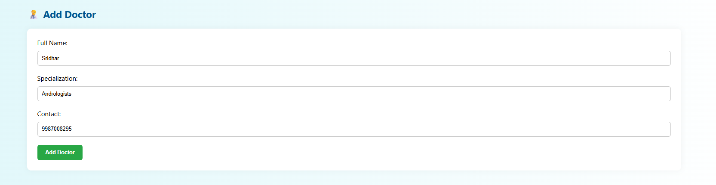
Add Doctor

Slide 10
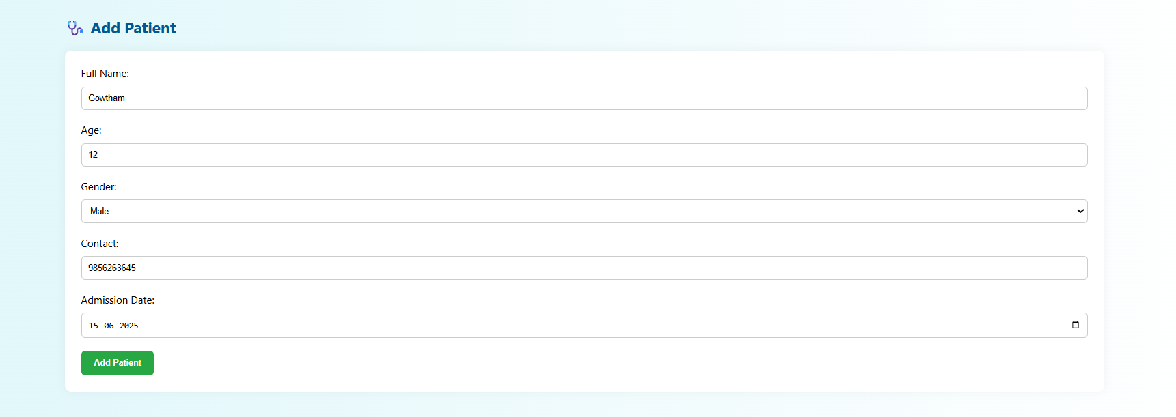
Add Patient

Slide 11
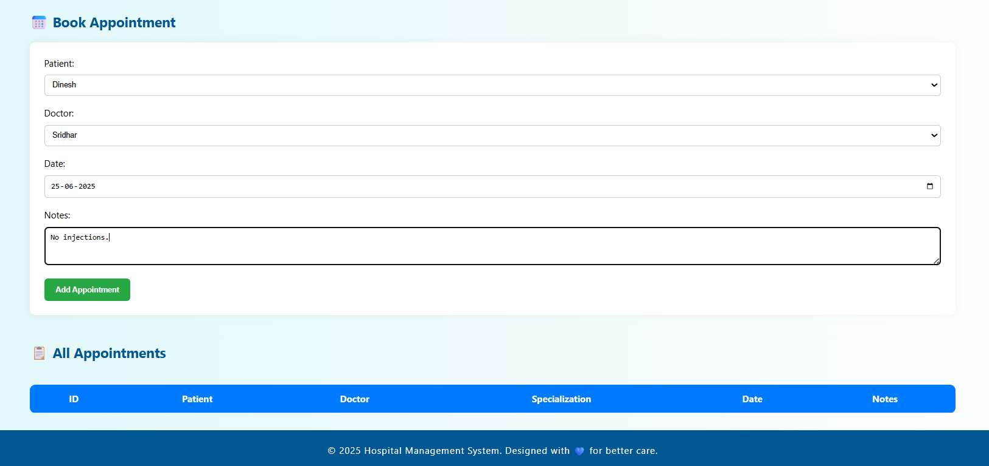
Book Appointment

Slide 12
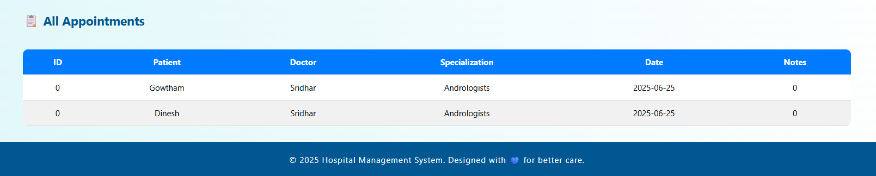
All Appointments

Slide 13
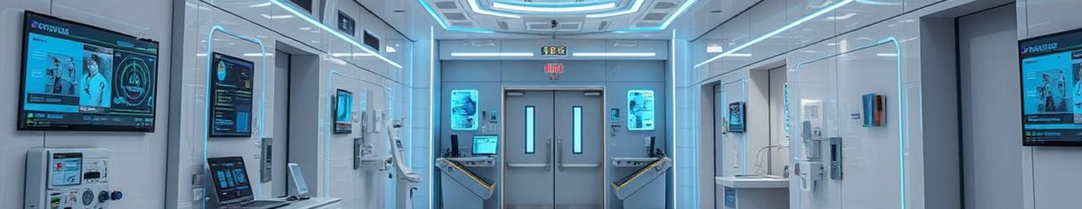
Conclusion
The Hospital Management System simplifies and automates key hospital tasks.It reduces errors and saves time by replacing manual processes.The user-friendly interface allows easy access to patient and doctor records.Real-time data improves coordination and decision-making.Overall, it enhances efficiency and organization in healthcare management.

